Slide 1

PowerShell
Trainer – Jitendra Singh Tomar

Slide 2

What is PowerShell?
PowerShell is a task automation and configuration management framework from Microsoft, consisting of a command-line shell and associated scripting language.
Windows Command Shell
Accepts Command from command line - cmdlets
You can navigate the file system and the registry
You can run scripts
You can run script directly from the command line

Slide 3
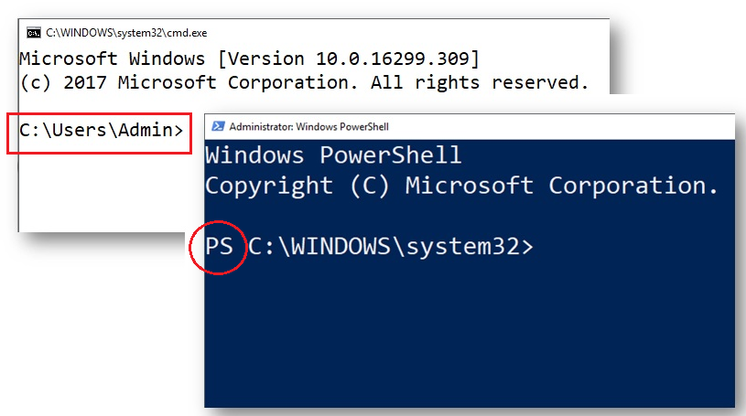
CMD vs PS

Slide 4
PowerShell Version
PowerShell v1 (PS 1.0)
In Nov, 2006 for XP, WinServer 2003 SP1, Windows Vista.
Optional in Win Server 2008.
PowerShell v2 (PS 2.0)
Integrated with Win7 & Win SVR 2008R2.
Included 240 cmdlets.
Includes below features:
PS remoting
Jobs, Advance functions
Debugging, ISE.
New APIs.

Slide 5
PowerShell Version
PowerShell v3 (PS 3.0)
Integrated with Win 8 & Win SVR 2012.
Supports WinRM service. (5985/5986)
Job scheduling, session connectivity, help update, auto module detection.
PowerShell v4 (PS 4.0)
Integrated with Win 8.1 & Win SVR 2012R2.
Includes DSC, execution policy, save-help, ‘where’ & ‘foreach’.
PowerShell v5 (PS 5.0 or PS 5.1)
Integrated with Win10 & Win SVR 2016.
Includes Chocolatey's repository-based package management.

Slide 6
PowerShell Version
PowerShell 5.1
It was released along with the Windows 10 Anniversary Update.
PowerShell 5.1 is the first version to come in two editions of "Desktop" and "Core".
"Desktop" edition is the continuation of the traditional Windows PowerShell
"Core" edition runs on .NET Core and is bundled with Windows Server 2016 Nano Server
PowerShell Core 6.0
Cross-platform, independent of Windows, free and open source.
It’s a new edition of PS that is cross-platform (Windows, macOS, and Linux), open-source, and built for heterogeneous environments and the hybrid cloud.
Supports MacOS & Linux.
Setup renamed from “powershell.exe” to “pwsh.exe”

Slide 7
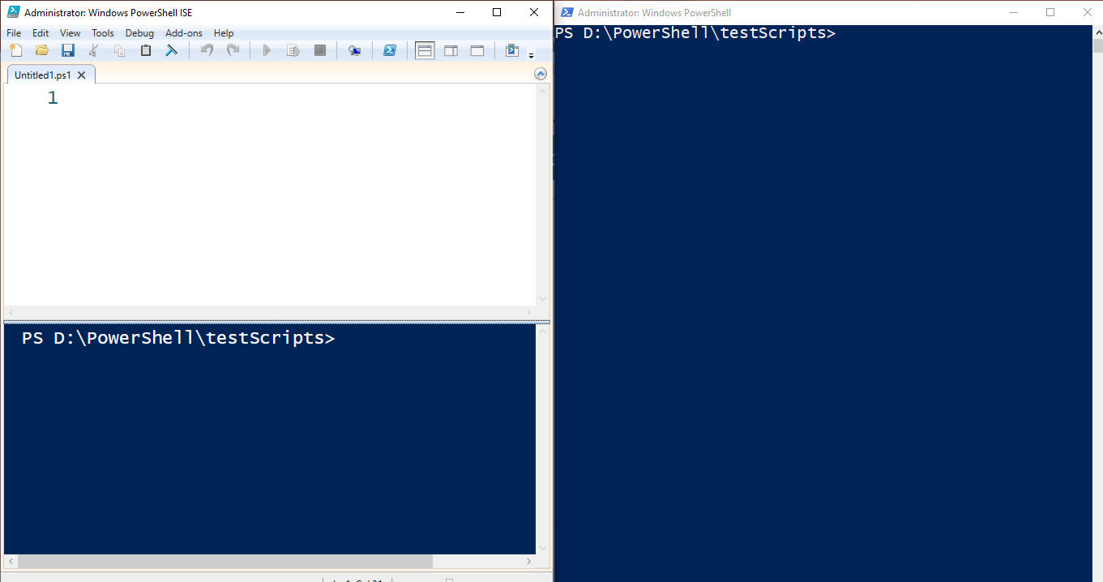
PowerShell vs Integrated Scripting Environment (ISE)

Slide 8
File extensions
PS1 – Windows PowerShell script
PSD1 – Windows PowerShell data file (for Version 2)
PSM1 – Windows PowerShell module file (for Version 2)
PS1XML – Windows PowerShell format and type definitions
CLIXML – Windows PowerShell serialized data
PSC1 – Windows PowerShell console file
PSSC – Windows PowerShell Session Configuration file

Slide 9
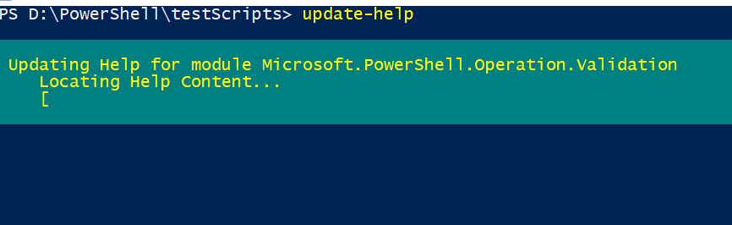
Updating PowerShell

Slide 10
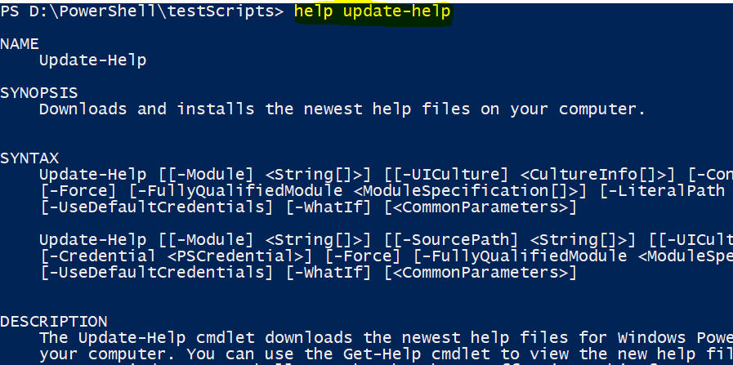
Help command

Slide 11
Upgrade PowerShell
V2 -> V4 (DotNet FW 4.0 required)
V3 -> V4/V5 (DotNet FW 4.0 required, 4.5.0 required)
V4 -> V5 (DotNet FW 4.5 required)

Slide 12
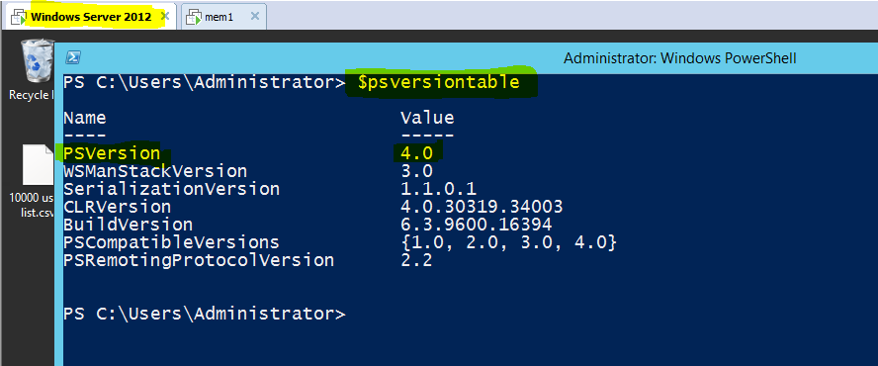
Upgrade PowerShell (before upgrade)

Slide 13
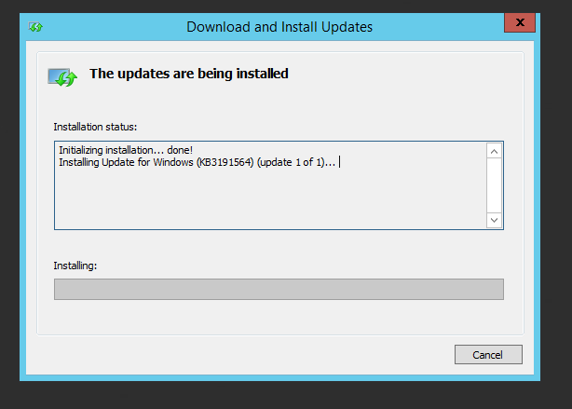
Upgrade PowerShell (While upgrade)

Slide 14
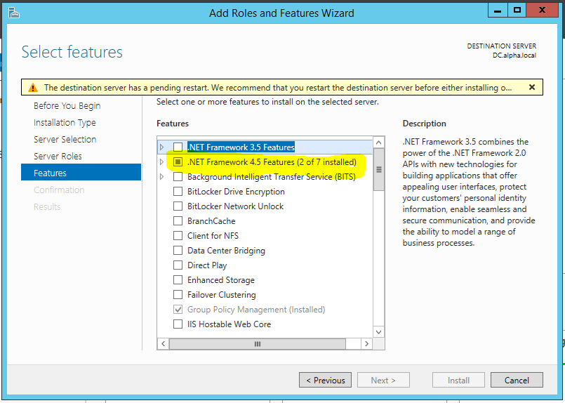
Upgrade PowerShell (While upgrade)

Slide 15
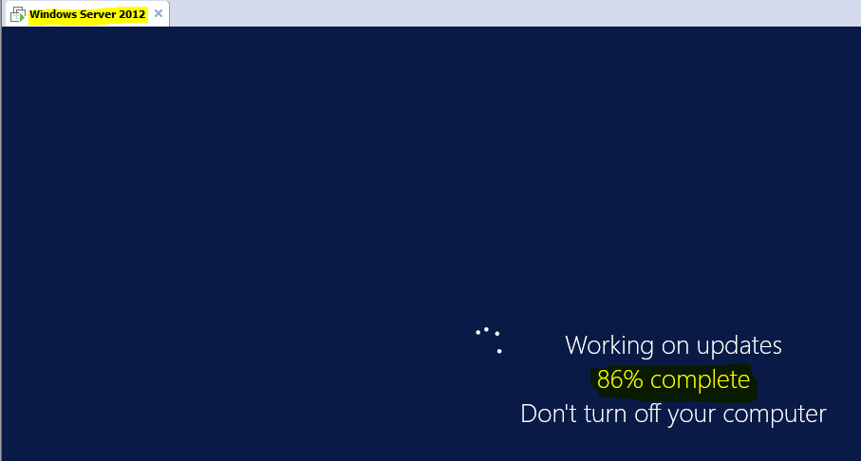
Upgrade PowerShell (While upgrade)

Slide 16
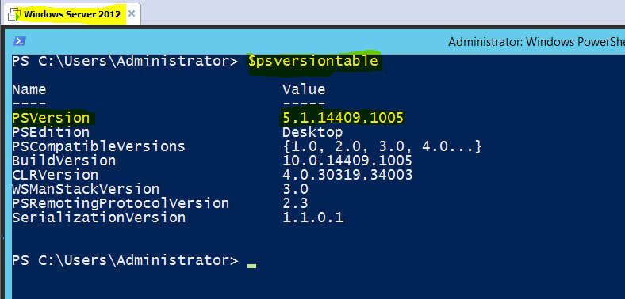
Upgrade PowerShell (after upgrade)

Slide 17
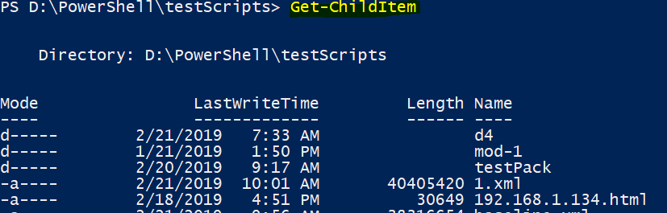
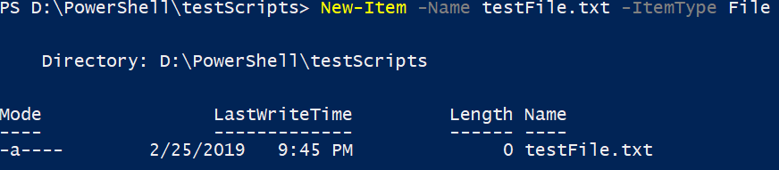
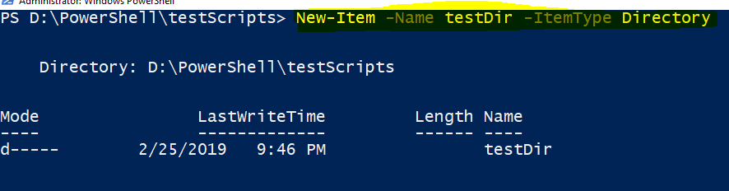
Working locally with PS

Slide 18
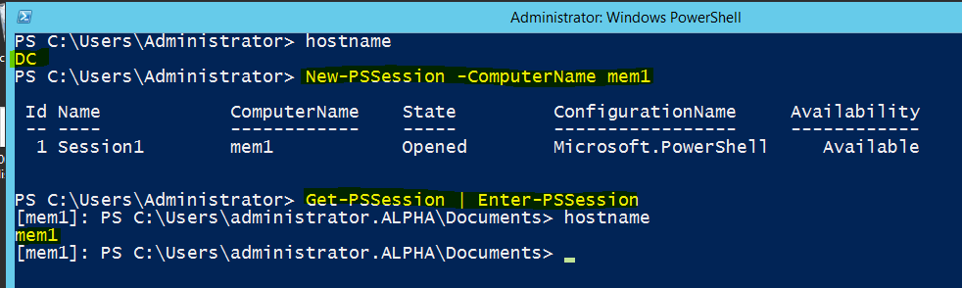
Working remotely with PS

Slide 19
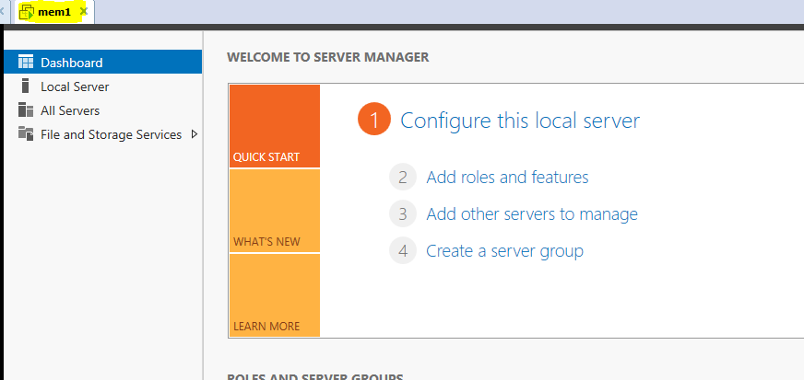
Working remotely with PS – Before installing IIS webserver

Slide 20
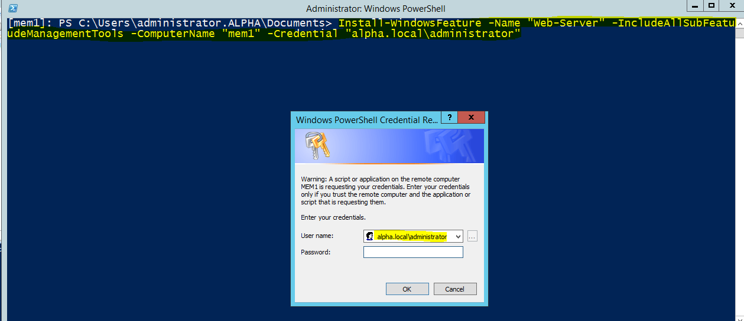
Working remotely with PS – After installing IIS webserver

Slide 21
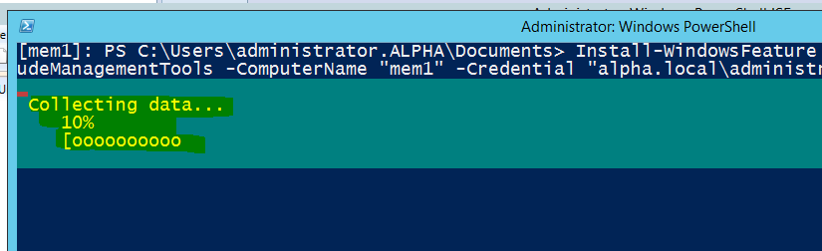
Working remotely with PS – After installing IIS webserver

Slide 22
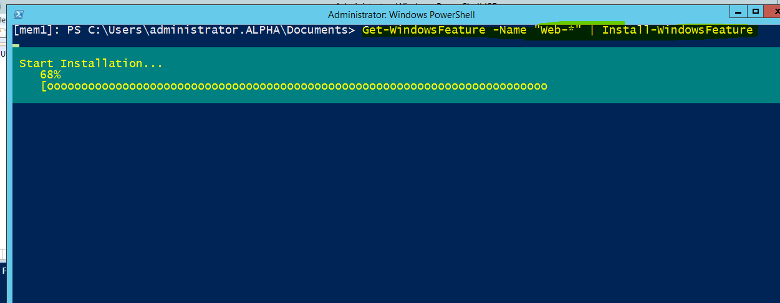
Working remotely with PS – After installing IIS webserver

Slide 23
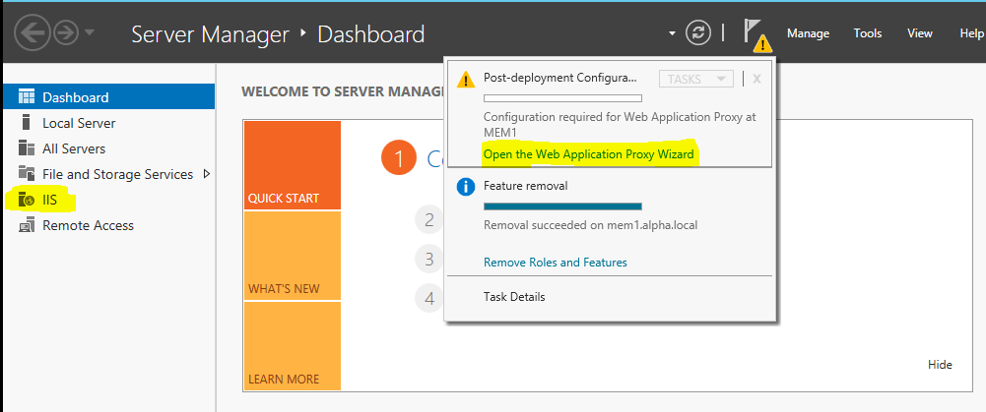
Working remotely with PS – After installing IIS webserver

Slide 24
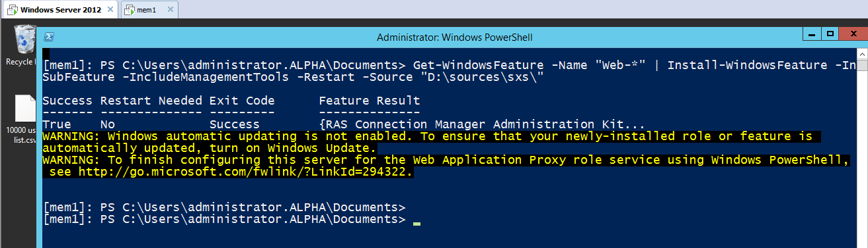
Working remotely with PS – After installing IIS webserver

Slide 25
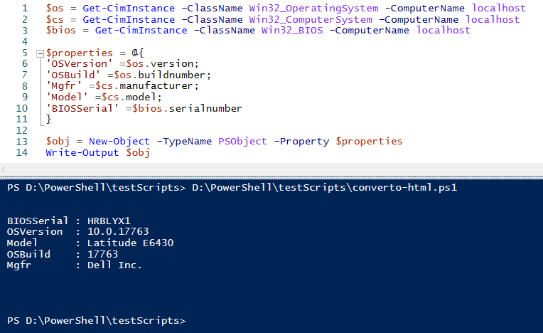
Creating scripts with ISE.

Slide 26
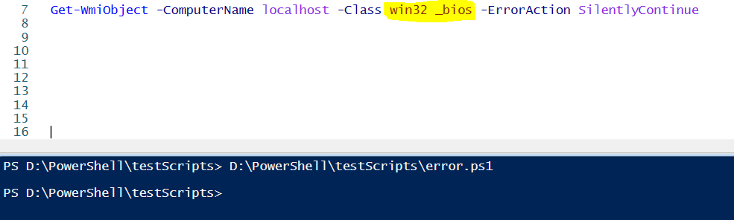
Error handling with PS

Slide 27
PS integration with other products
Integration with several Microsoft products:
Microsoft Azure
Microsoft SQL server
Visual Studio
Office 365
Power BI
Windows Servers
AWS
Exchange server
Skype
SharePoint
DSC - Linux

Slide 28


